Slide 1

Senior Design Check-off #3
Computer Vision Module
Cameron Henning

Slide 2

Completed for this check-off:
Template matching
Multiple lines of measures
More than 1 instance of the same note
Key Signature, Tempo, Time Signature, Dynamics
Notes: Quarter, Half, Whole
Rests: Quarter, Half, Whole, Eighth, Sixteenth

Slide 3

Results

Slide 4
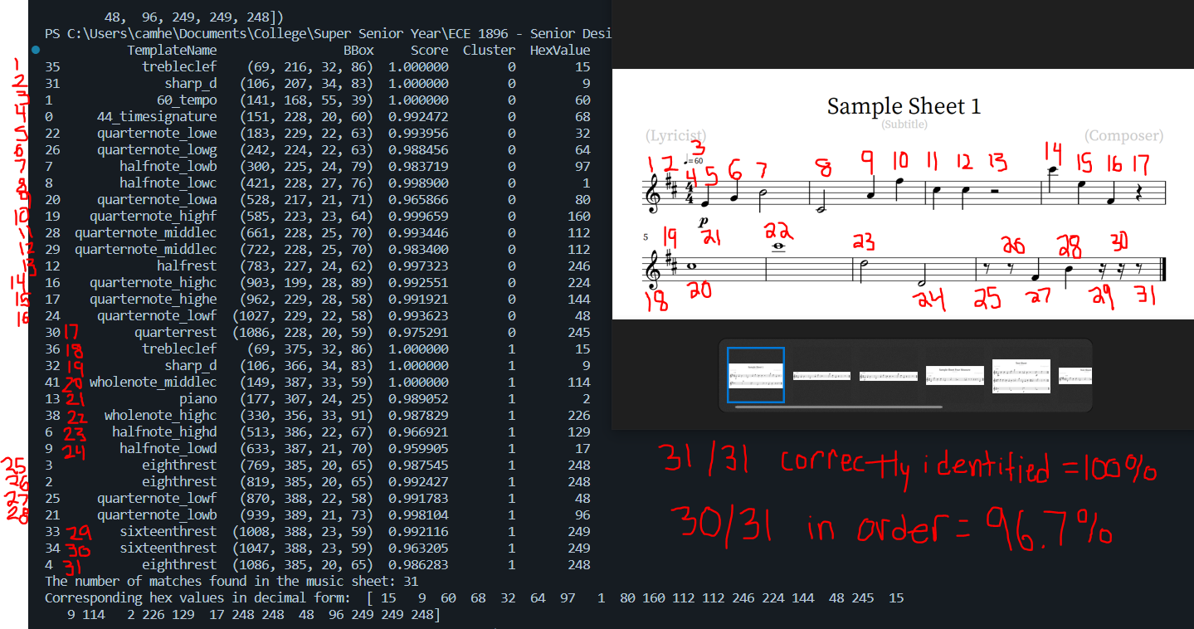

Slide 5
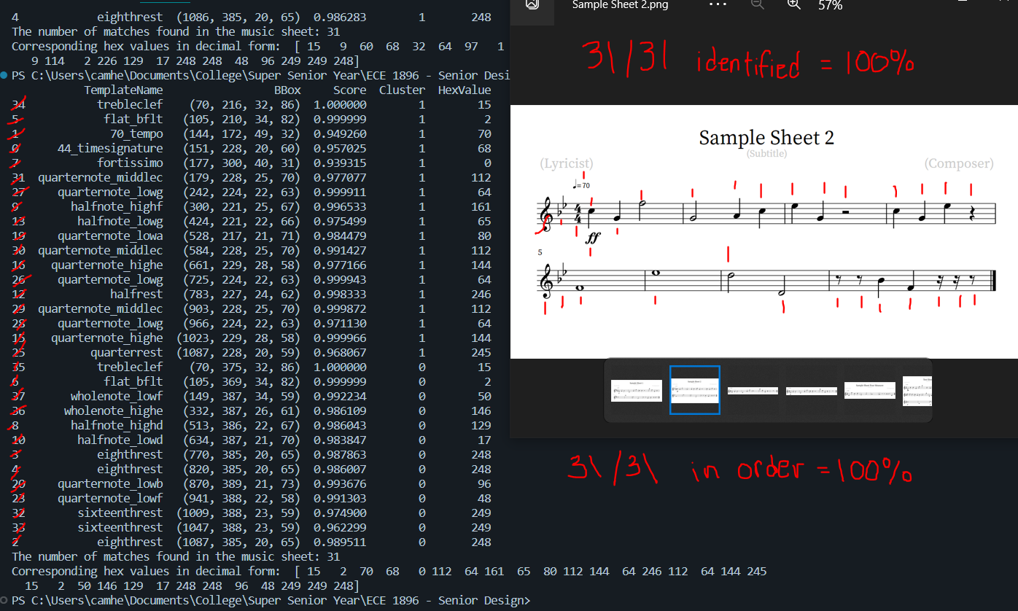

Slide 6
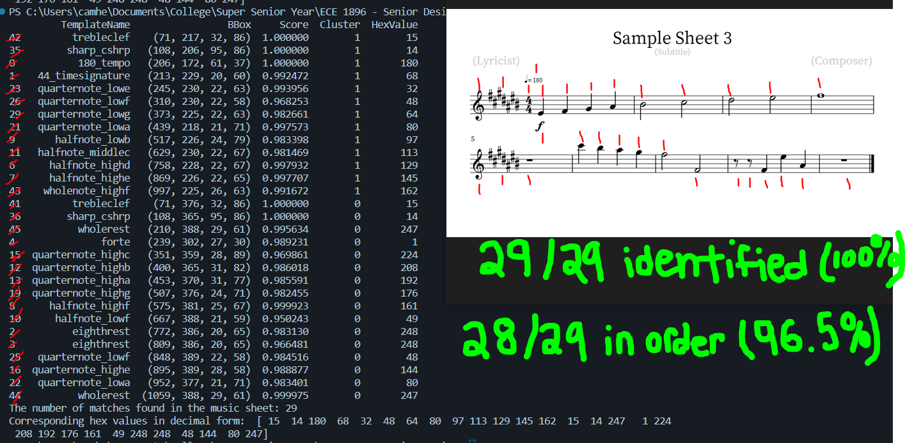

Slide 7
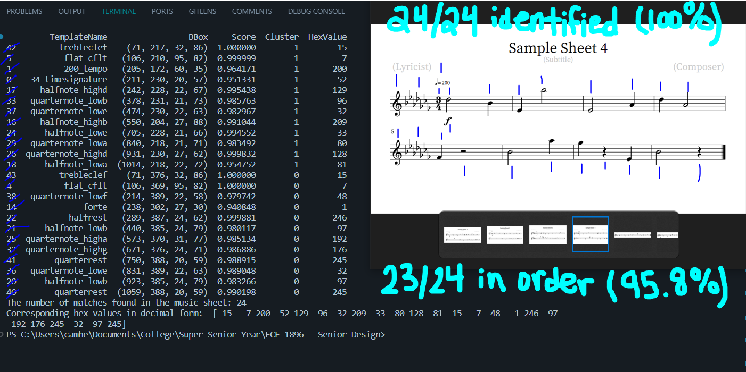

Slide 8
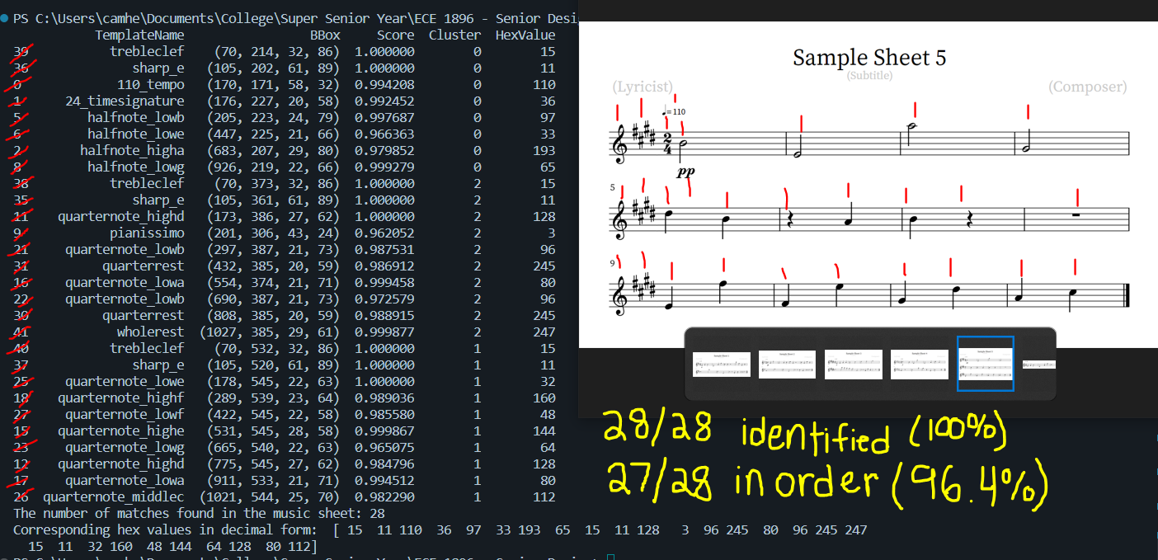

Slide 9
Takeaways
Overall accuracy at identifying the music objects: 100%
Overall accuracy at sorting the objects in order: 97.1%
Template that didn’t show up in output → Redo screenshot with higher quality tool → fixed the issue
Pianissimo, piano, and forte outputted out-of-order
Due to clustering algorithm → y-coordinate of dynamic closer to 1st object of 2nd cluster than last object of 1st cluster

Slide 10
Goals for Final Presentation
Create full-length music sheets
Test all templates
Create default method for key signature and dynamics
C Major for Key signature
Fortissimo (very loud) for Dynamics
Modify output for Jack to use

Slide 11
How it Works:
Input sheet music and templates
Load list of templates and music sheet into matchTemplates() method
Set threshold to 0.93
Set search box to start at (0,0) → 3000 pixels wide x 750 pixels height
TM_COEFF_NORMED → method used for matching
Uses normalized cross-correlation to match the template
Set maxOverlap to 0.3 (no more than 30% overlap allowed between any 2 templates)
This is to prevent the same object being counted more than once
Input matches into a K-Means clustering algorithm
# of clusters = # of treble clefs found
Sort the different clusters by y-coordinate
Once sorted, sort the cluster’s information by x-coordinate
Create corresponding hex array as an output

